Slide 1

Standards, Assignments & Grade Scales…
OH MY!
Bob Cornacchioli
DERO Technical Services
bcornacchioli@gmail.com
get2bobc@gmail.com
www.derotechnical.com

Slide 2

Closer look at Grade Scales, Standards and Assignments
Testing Score Types
Assignment Scores auto calculating standards scores
Professional Judgements
Overwrite PTP Math – last three
Agenda/Participants will be engaged in:
All PPT can be found @
www.derotechnical.com

Slide 3




CEO - DERO Technical Services (2007)
Marketing/- ParkBench Software Trainer (2007)
Evangelist/Process Lead- Level Data (2010)
PSISJS Partner – Standards/Trainer (2013)
Alpha/Beta Team for PS and PTP
Bob Cornacchioli
Director of Technology and Media Services
Shrewsbury Public Schools (16 yrs.)
PowerSchool Administrator (6 yrs.)

Slide 4
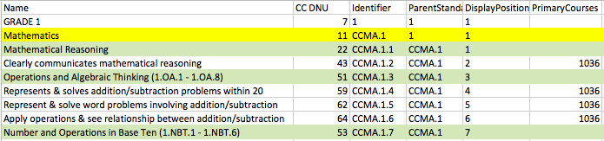
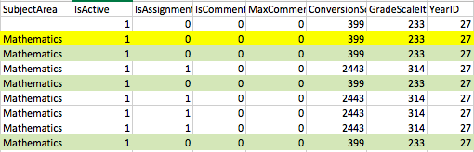
Standards Spreadsheets

Slide 5
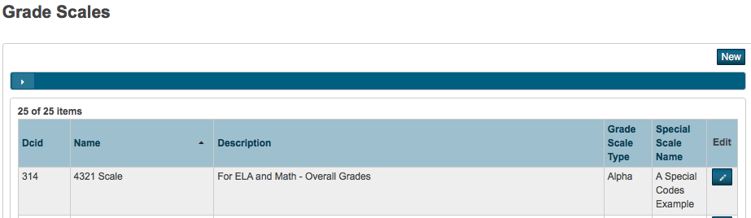
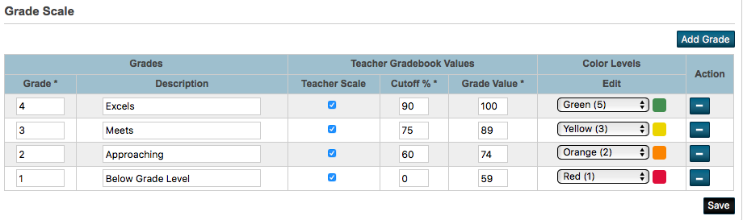
Grade Scales

Slide 6
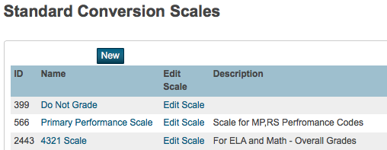
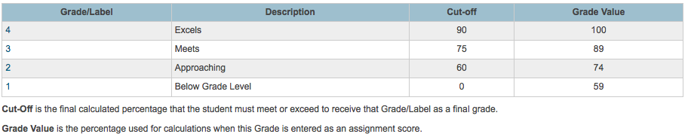
Conversions Scales were for Standards
Using ONLY PTP?
Need only a valid conversion scale

Slide 7
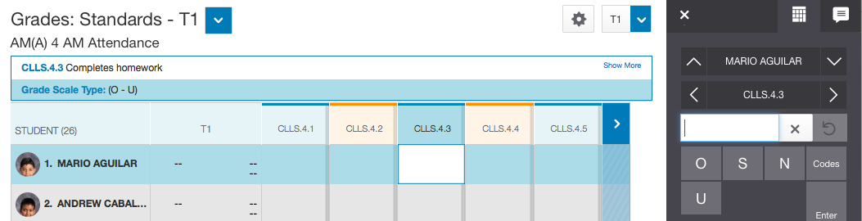
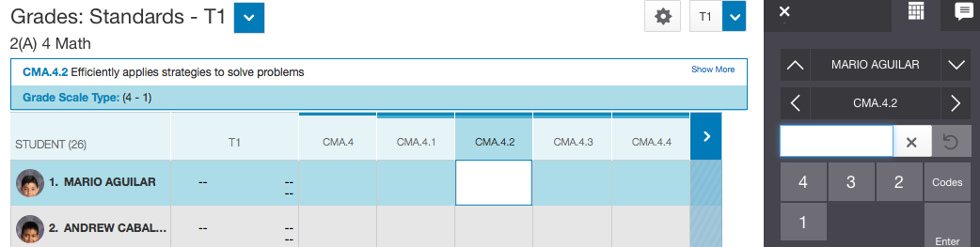
OSNU for Behaviors
4321 for Academics
If your scales includes “in-between values”
the Score Inspector will give you OTHER options!

Slide 8

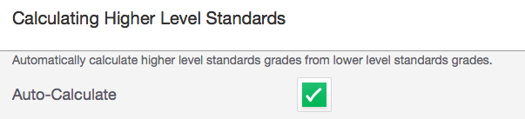
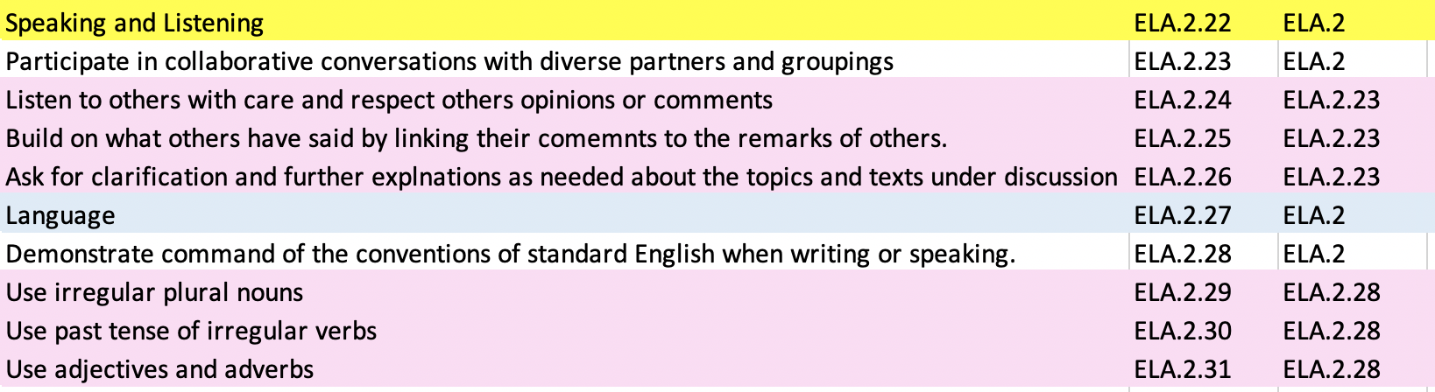
Gradebook Preferences:
Calculate Higher Level Standards
SELDOM REQUESTED ANYMORE
PowerTeacher Pro

Slide 9
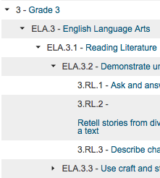
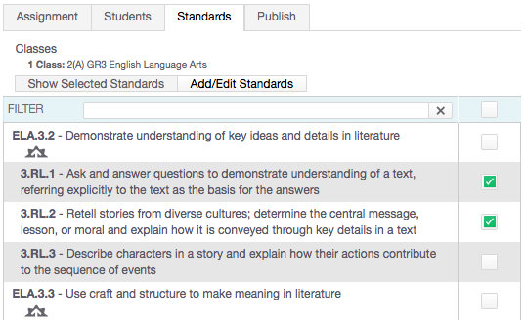
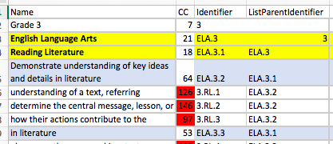
ListParentIdentifier - Rollup
ListParentIdentifier – places “child” standards under their parents
KNOWN ISSUE
The Parent Standard which is auto-calculated by it’s child standards SHOULD NEVER be selected to be associated to an assignment!

Slide 10
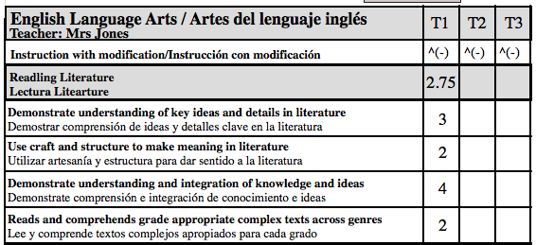
Why Calculating Higher Level Standards Doesn’t Always Work for Teachers
10
2
1
3
Depending Upon Your Scale Cut-off/Grade Values does 2.75 become a 2 or a 3?
Does each lower level standard contribute 25% of the Reading Literature Grade?

Slide 11
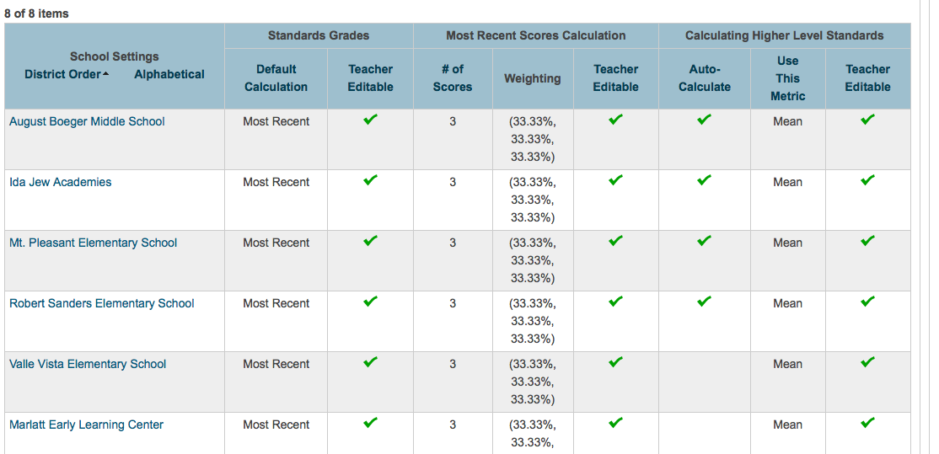
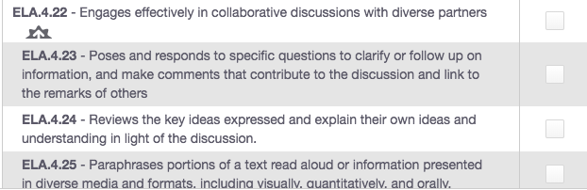
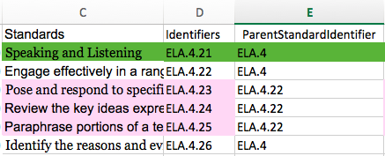
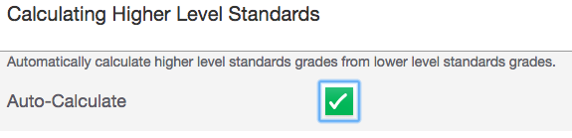
Decisions before creating XLS Import Template
1) To Roll-up or Not
2) ListParentIdentifier
is the KEY
3) Selecting Auto-Calculate
Is essential
(Teacher or District)

Slide 12
Score standard without tying it to an assignment
Sept 9th - CMA.4.2 - Efficiently applies strategies to solve problems
4
Sept 20th - CMA.4.2 - Efficiently applies strategies to solve problems
3
Oct 2nd - CMA.4.2 - Efficiently applies strategies to solve problems
2
Oct 15th - CMA.4.2 - Efficiently applies strategies to solve problems
4
4
You really can’t direct enter a score for a standard without overwriting all previous grades.
LAST IN WINS HOWEVER
Some Academic Standards NOT tied to assignments & Behavioral Standards will be scored using direct entry near or at the end of each term!
DO YOU REMEMBER – FINAL GRADE ENTRY OF PTG?

Slide 13
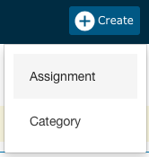
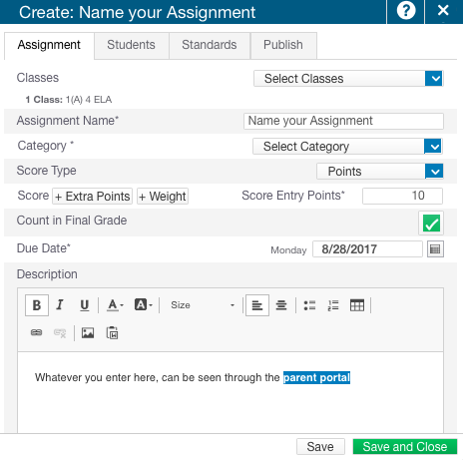
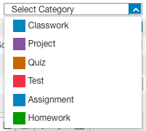
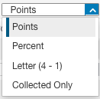
LET’S CREATE AN ASSIGNMENT…
BEST PRACTICES
CREATE ONE
ASSIGNMENT
WITH EACH
SCORE TYPE TO CHECK IF CONVERSIONS ARE WORKING

Slide 14
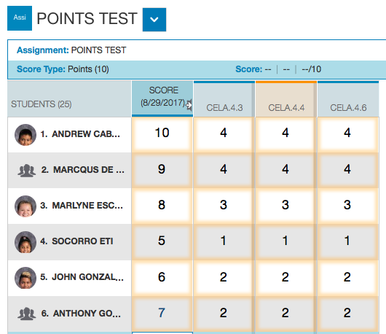
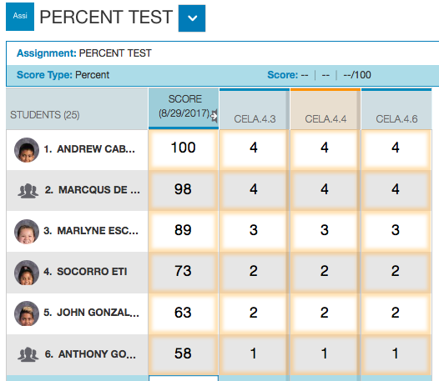
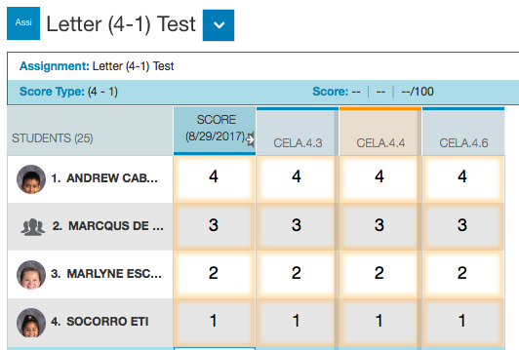
3 SCORE TYPES
(That will auto-calculate any standards associated to assignments!)
Everyone gets 3 SCORE TYPES
POINTS, PERCENT, COLLECTED
PLUS 1 – GRADE SCALE OF THE COURSE
Jason Springel has suggested teachers use the same score type all the time!

Slide 15
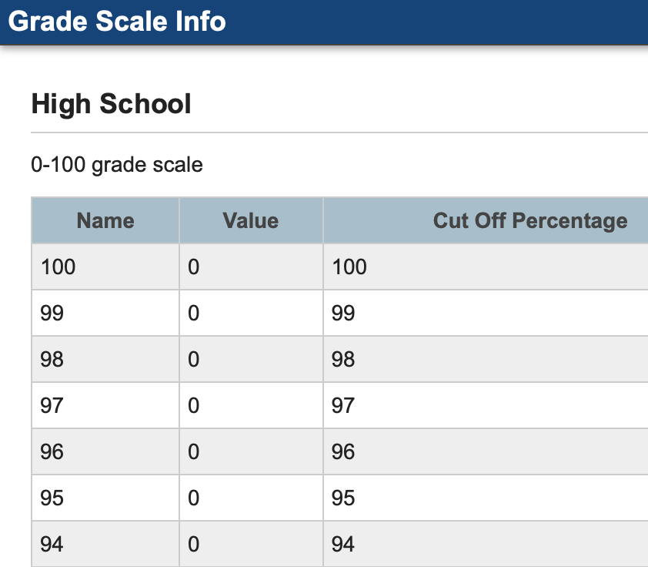
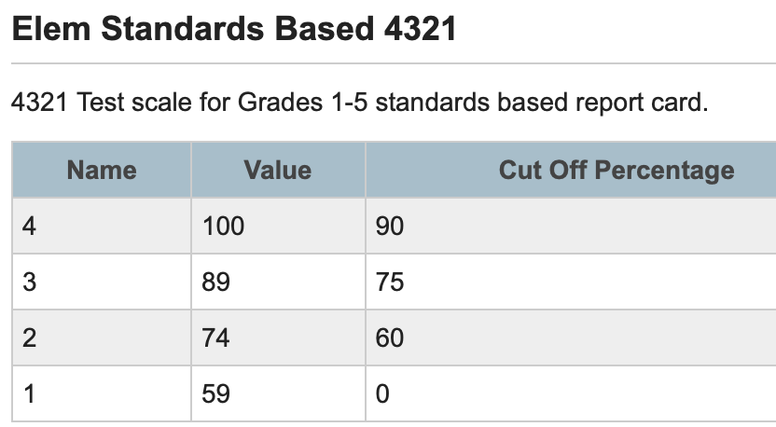
Course Grade Scales/Standards
Grade 3 Math Course

Slide 16
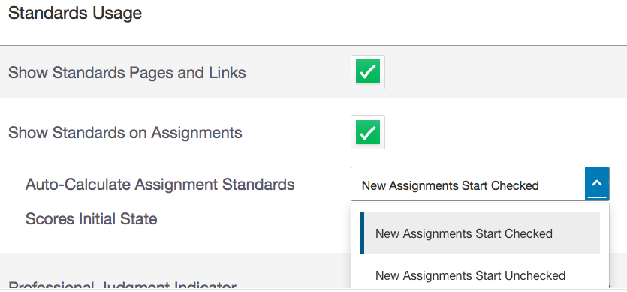
Some teachers might want the score of assignments to
AUTO-CALCULATE the score of any standards associated to them.
BEFORE A NEW ASSIGNMENT IS CREATED – use the settings button on left> Display Settings – scroll down to Standards Usage.
Teachers MUST SELECT New Assignments Start Checked*
*Can’t be done for all at the district level

Slide 17
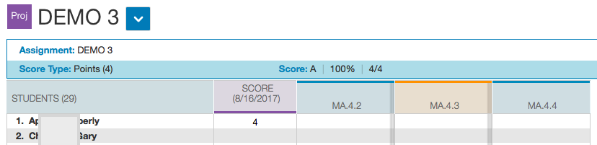
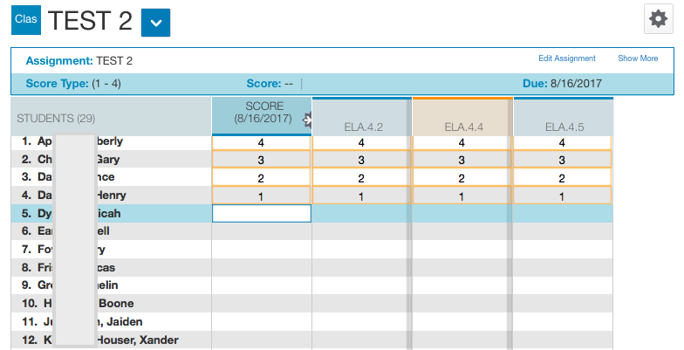
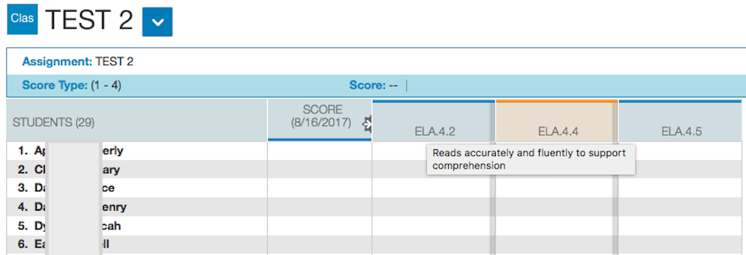
Above - you can see an assignment with standards attached
Below – you can see an assignment with standards attached with AUTO CALCULATED √
Below – ONCE THE ASSIGNMENT IS SCORED – All standards associated to it also get scored

Slide 18
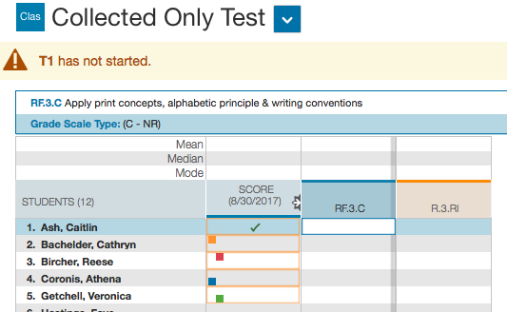
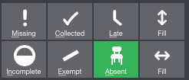
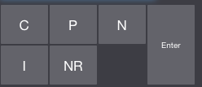
Collected Only Type
Auto Calculated Standards from Assignments

Slide 19
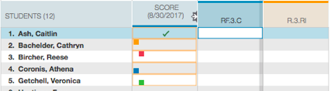
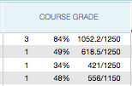
Collected Only could be called Standards Only
The value of these scoring options is equal to BLANK!

Slide 20
Summarizing Scoring of Options
Some of your standards lend themselves very nicely to be tied to assignments while others - not so much.
Standards tied to Assignments
  Any standard assessed more than once in a given term will be averaged by PTP. Rarely do may standards get assessed more than three times in a given term.
  The AVERAGING by the PTP default takes the last three scores. Averages can always be overwritten by teachers using their professional judgement.
  Teachers have the choice to either have PTP auto calculate standards scores equally or manually enter individual standard scores
  Tying standards to assignments provides teachers evidence over time of student progress/growth.
Standards that aren’t tied to Assignments
  Like Final Grade Entry in the former gradebook PTG – Teachers can score standards quickly with fill down options in a given term. Scores entered in this fashion must have other forms of evidence as they weren’t tied to assignments.

Slide 21
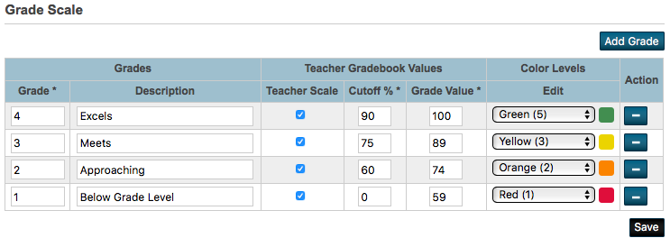

PTP Scoring of Standards tied to Assignments
Chapter 1 Questions
95 = 4
Best Chef Book Test
89 = 3
Amelia Bedelia
82 = 3
PTP
GRADE
VALUE
AVERAGE
95
89
82
266
Divide by 3
88.6
100
89
89
278
Divide by 3
92.6
88.6 = 3
92.6 = 4
4
3
3
CELA.4.3 – Reads accurately and fluently to support comprehension

Slide 22

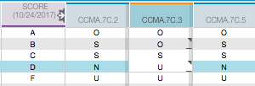
To Overwrite or Accept PTP Math?
At the time of Auto Calculation

Slide 23
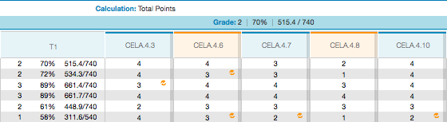
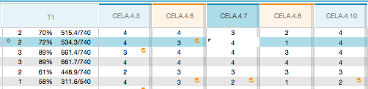
To Overwrite or Accept PTP Math?
After the Fact

Slide 24
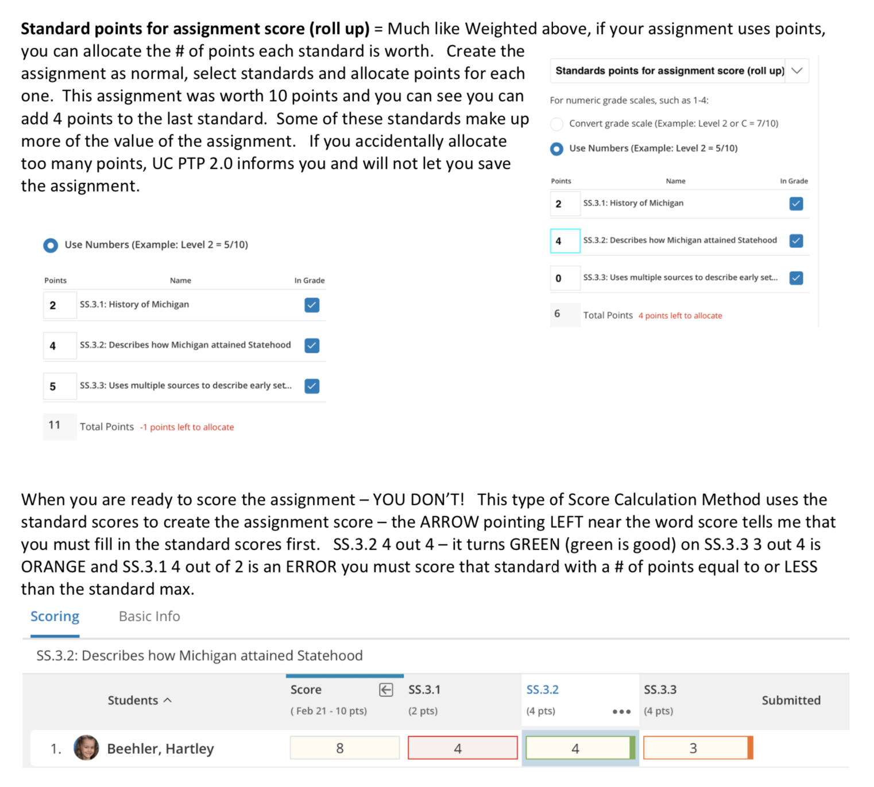
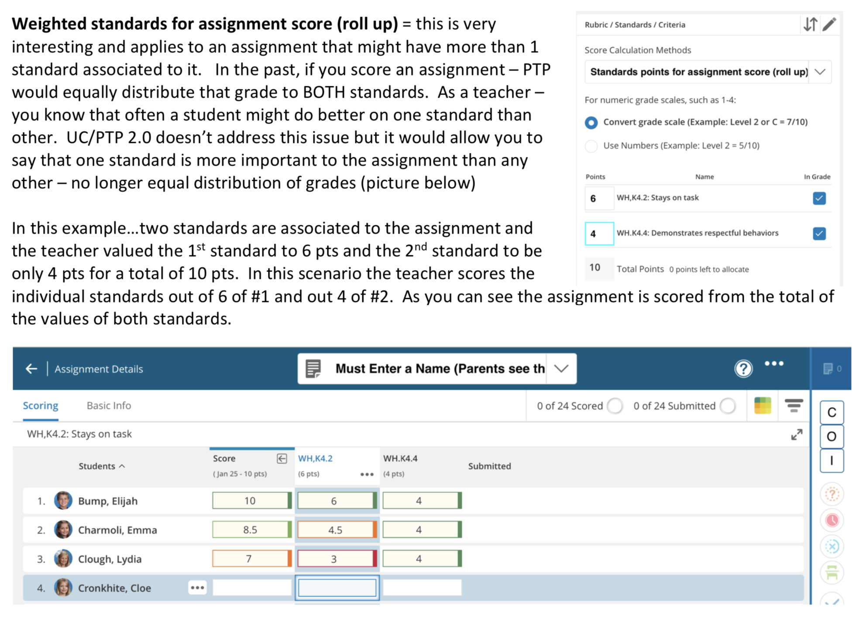
Gradebook Changes in Unified Classroom

Slide 25
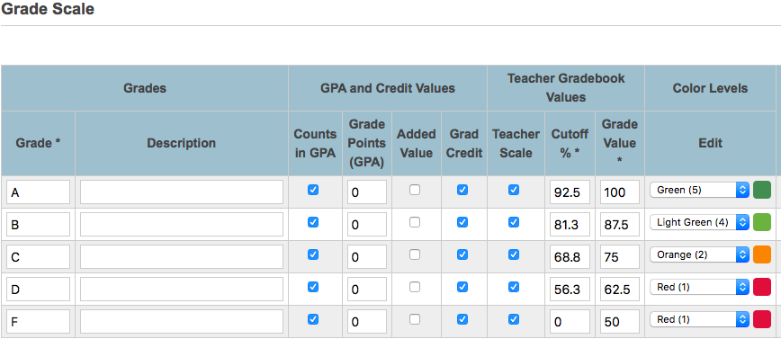
RECENT QUESTIONS AND ANSWERS
“I created an assignment and tied standards to it. No matter what the score of the assignment, all standards auto calculated as an U!”
Assignments scores use the GRADE SCALE OF THE COURSE!
Standards scores use the GRADE SCALE assigned to the standard (import template)

Slide 26
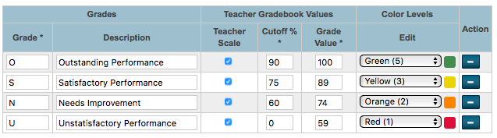
RECENT QUESTIONS AND ANSWERS
“I created an assignment using a 4 point scale, I can’t get any N’s to appear. I always have to overwrite the U to an N”
Values of a 4 point scale
4 out of 4 = 100%, 3 out of 4 = 75%,
2 out of 4 = 50%, 1 out of 4 – 25%
N = Needs Improvement 60 - 74

Slide 27
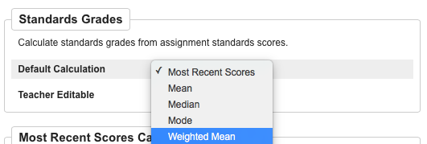
RECENT QUESTIONS AND ANSWERS
Can the final standard grade ever be more than the average of all the standard scores, shouldn’t standards associated to test assignments count more?
Once Assignment Weighting is complete from EITHER the district or teacher’s PTP gradebook, then
From the District - PTP Settings – Standard Grade Calculation
(Change Most Recent to Weighted Mean)

Slide 28
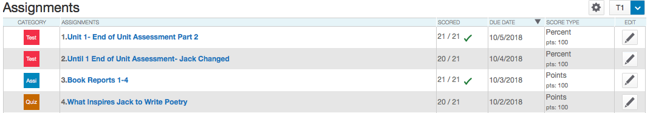
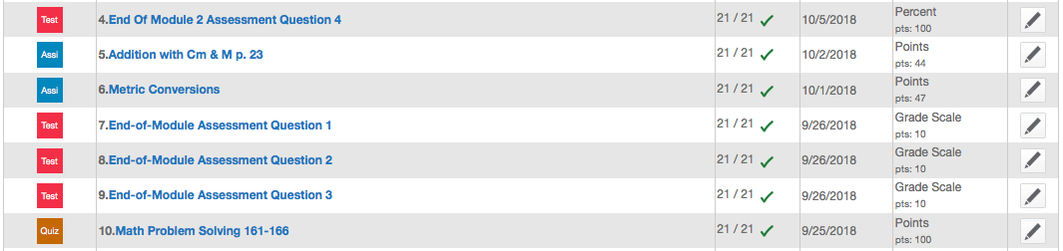
Best Practices – Use the same Score Type
Do all assignments contribute to standard final grade equally?

Slide 29
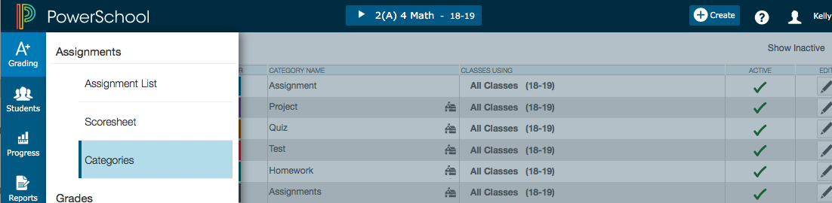
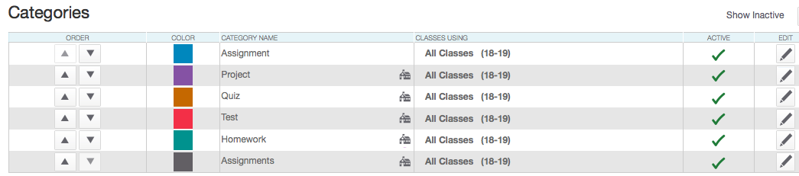
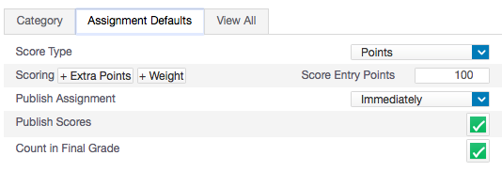

DEFAULT CATEGORY SETTING

Slide 30


PROGRESS>STANDARDS –
THIS DISPLAY SPEAKS VOLUMES!

Slide 31

Assignment with Auto Calculated Scores
to selected Standards

Slide 32


Scoring the Assignment (75) converts to the value of the standards
Score Inspector allows you to enter a score
Each standard receives the same value regardless

Slide 33


Slide 34


Slide 35

Student Progress – Teachers can change the Most Recent 3
Please note: 99% of districts that I have worked with use the standard grades default calculation option of Most Recent 3. If you use any other option, the 3 Green Circles will not be displayed.
( Mean, Median, Mode, Weighted Mean, Highest, None)

Slide 36

EVEN SIMPLIER w PS V 11.0.4.1 (Jan)

Slide 37



Settings > Standards Grade Calculations
Since teachers can use Professional Judgement the default is fine!

Slide 38


Professional Judgment Indicator
If you work with standards grades, the Professional Judgment Indicator is designed to assist you in assessing standards grades.
The indicator helps you understand which grades to focus on to determine if the final grade accurately reflects the student’s level of understanding.
Here’s an example of when the indicator appears:
The most recent scores for a standard are 1, 1, 1, 4, and 4, respectively, and all have different metrics. The Professional Judgment Indicator appears on the calculated final grade field to bring to your attention to the fact that one of the three most recent scores is actually higher than the final grade.
Using your professional judgment, you can decide how you want to impact the final grade. You may override the final grade, or you can make the score anomaly exempt.

Slide 39


More in-depth Grade Scale Info
Episode 12 3/24/17
11 MIN TIME STAMP
https://support.powerschool.com/d/insider

Slide 40

Grade Scale per Student
(changing scales)

Slide 41

Visual Cues - Changed Grade Scale

Slide 42


Standard Grade Rollup Settings

Slide 43

PS 12.0.1 >Transfer Students and Grades
KB 81397
PS recently created district-level options to allow districts to choose how to handle standards grades for transferred students.
1) DATs will report a grade based on the options set
2) Fixed pre-existing issue regarding not honoring excluded grades
3) Updated the standards grade rollup drawer to more clearly report to admins what is and what is not included in the standards grade rollup for a particular standard.
4) Portal shows only the grades that contribute to the rollup.

Slide 44

Standards Grade Rollup Settings Talking Points
START
OF TERM
MIDDLE
OF TERM
END
OF TERM
SENDING TEACHER EXCLUDING
STANDARD SECTION GRADES ALREADY SCORED
EXCLUDING GRADES FROM DROPPED CLASSES
RECEIVING TEACHER – LOTS OF WORK AT END OF TERM
WHICH TEACHERS GRADES COUNT MORE
AVERAGE STANDARD GRADES
SCORED TWICE IN THE SAME TERM

Slide 45

Once on PS 12.0.X
√
If checked, any grades a teacher marked exempt are not included in the standard grade rollup.
√
If checked, any grades from classes the student has dropped will not be included in the standard grade rollup unless there are no active grades. In the case of no active grades, grades from dropped classes are included.
When there are grades only from dropped classes, the district has the option to report the average of all dropped grades, or just the grade from the most recently enrolled class. Use the Calculation Method When Only Dropped Classes menu to choose whether to average the grades or to use Most Recent Enrolled only the last grade.

Slide 46









GRADE LEVEL MEETINGS
NEIGHBOR
MENTOR/PRINCIPAL/PILOT
IF NOT
MAYBE IT SHOULD BE!
IS PTP/GRADING A TOPIC AT EACH FACULTY MEETING??
FACULTY MEETINGS – MIXED AGENDAS - ADMIN & TEACHER LED

Slide 47
ANY AND ALL DERO RESOURCES ARE AVAILABLE
TO DOWNLOAD, TWEAK and USE FOR YOUR DISTRICT!
Q & A
Bob Cornacchioli
get2bobc@gmail.com
www.derotechnical.com

